Slide 1
Chapter -4
PHP Basics

Slide 2
What is server side scripting ?
Web browsers communicate with web servers using the HyperText Transfer Protocol (HTTP). When you click a link on a web page, submit a form, or run a search, an HTTP request is sent from your Browser to the target server.
The request includes a URL identifying the affected resource, a method that defines the required action (for example to get, delete, or post the resource), and may include additional information encoded in URL parameters (the field-value pairs sent via a query string), as POST data (data sent by the HTTP POST method), or in associated cookies.
Web servers wait for client request messages, process them when they arrive, and reply to the web browser with an HTTP response message. The response contains a status line indicating whether or not the request succeeded (e.g. "HTTP/1.1 200 OK" for success).
The body of a successful response to a request would contain the requested resource (e.g. a new HTML page, or an image, etc...), which could then be displayed by the web browser.

Slide 3
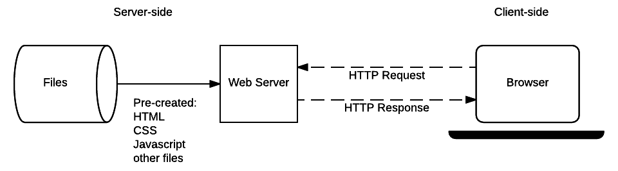
Static Site
The diagram below shows a basic web server architecture for a static site (a static site is one that returns the same hard-coded content from the server whenever a particular resource is requested). When a user wants to navigate to a page, the browser sends an HTTP "GET" request specifying its URL.
The server retrieves the requested document from its file system and returns an HTTP response containing the document and a success status (usually 200 OK). If the file cannot be retrieved for some reason, an error status is returned (see client error responses and server error responses).

Slide 4
Dynamic Site
A dynamic website is one where some of the response content is generated dynamically, only when needed. On a dynamic website HTML pages are normally created by inserting data from a database into placeholders in HTML templates (this is a much more efficient way of storing large amounts of content than using static websites).
A dynamic site can return different data for a URL based on information provided by the user or stored preferences and can perform other operations as part of returning a response (e.g. sending notifications).
Most of the code to support a dynamic website must run on the server. Creating this code is known as "server-side programming" (or sometimes "back-end scripting").
The diagram below shows a simple architecture for a dynamic website. As in the previous diagram, browsers send HTTP requests to the server, then the server processes the requests and returns appropriate HTTP responses.
Requests for static resources are handled in the same way as for static sites (static resources are any files that don't change —typically: CSS, JavaScript, Images, pre-created PDF files etc).

Slide 5
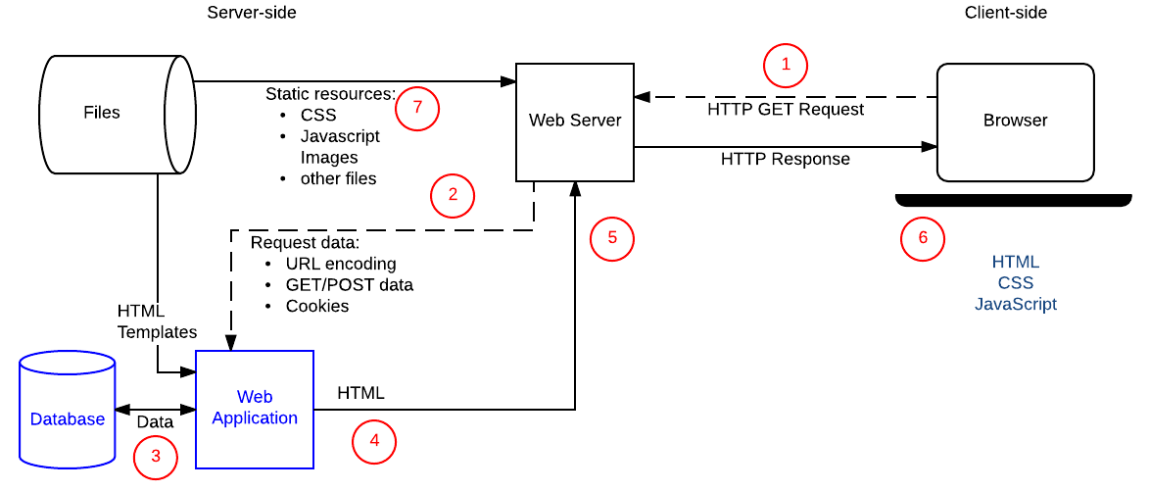

Slide 6
Continue…
Requests for dynamic resources are instead forwarded (2) to server-side code (shown in the diagram as a Web Application). For "dynamic requests" the server interprets the request, reads required information from the database (3), combines the retrieved data with HTML templates (4), and sends back a response containing the generated HTML (5,6).

Slide 7
What is PHP?
PHP is an acronym for "PHP: Hypertext Preprocessor"
PHP is a widely-used, open source scripting language
PHP scripts are executed on the server
PHP is free to download and use
PHP is an amazing and popular language!
It is powerful enough to be at the core of the biggest blogging system on the web (WordPress)!
It is deep enough to run the largest social network (Facebook)!
It is also easy enough to be a beginner's first server side language!

Slide 8
Why PHP ?
PHP can generate dynamic page content
PHP can create, open, read, write, delete, and close files on the server
PHP can collect form data
PHP can send and receive cookies
PHP can add, delete, modify data in your database
PHP can be used to control user-access
PHP can encrypt data
PHP runs on various platforms (Windows, Linux, Unix, Mac OS X, etc.)
PHP is compatible with almost all servers used today (Apache, IIS, etc.)
PHP supports a wide range of databases
PHP is free. Download it from the official PHP resource: www.php.net
PHP is easy to learn and runs efficiently on the server side

Slide 9
Set Up PHP on Your Own PC
In order to develop and run PHP Web pages three vital components need to be installed on your computer system.
Web Server − PHP will work with virtually all Web Server software, including Microsoft's Internet Information Server (IIS) but then most often used is freely available Apache Server. Download Apache for free here − https://httpd.apache.org/download.cgi
Database − PHP will work with virtually all database software, including Oracle and Sybase but most commonly used is freely available MySQL database. Download MySQL for free here − https://www.mysql.com/downloads/
PHP Parser − In order to process PHP script instructions a parser must be installed to generate HTML output that can be sent to the Web Browser. This tutorial will guide you how to install PHP parser on your computer.

Slide 10
Xampp Installation
For Xampp installation refer below given link :
https://www.edureka.co/blog/how-to-run-a-php-program-in-xampp/

Slide 11
Basic PHP Syntax
A PHP script is executed on the server, and the plain HTML result is sent back to the browser.
A PHP script can be placed anywhere in the document.
A PHP script starts with <?php and ends with ?>:
<?php
// PHP code goes here
?>
The default file extension for PHP files is ".php".
A PHP file normally contains HTML tags, and some PHP scripting code.

Slide 12
PHP Variables
In PHP, a variable starts with the $ sign, followed by the name of the variable:
After the execution of the statements above, the variable $txt will hold the value Hello world!, the variable $x will hold the value 5, and the variable $y will hold the value 10.5.
When you assign a text value to a variable, put quotes around the value.
Unlike other programming languages, PHP has no command for declaring a variable. It is created the moment you first assign a value to it.
<?php
$txt = "Hello world!";
$x = 5;
$y = 10.5;
?>

Slide 13
Rules for PHP variables
A variable starts with the $ sign, followed by the name of the variable
A variable name must start with a letter or the underscore character
A variable name cannot start with a number
A variable name can only contain alpha-numeric characters and underscores (A-z, 0-9, and _ )
Variable names are case-sensitive ($age and $AGE are two different variables)

Slide 14
PHP
PHP is a Loosely Typed Language
we did not have to tell PHP which data type the variable is.
PHP automatically associates a data type to the variable, depending on its value. Since the data types are not set in a strict sense, you can do things like adding a string to an integer without causing an error.
In PHP 7, type declarations were added. This gives an option to specify the data type expected when declaring a function, and by enabling the strict requirement, it will throw a "Fatal Error" on a type mismatch.

Slide 15
PHP echo and print Statements
echo and print are more or less the same. They are both used to output data to the screen.
echo has no return value while print has a return value of 1 so it can be used in expressions.
echo can take multiple parameters.
while print can take one argument.
echo is marginally faster than print.

Slide 16
PHP Data Types
Variables can store data of different types, and different data types can do different things.
PHP supports the following data types:
String
Integer
Float (floating point numbers - also called double)
Boolean
Array
Object
NULL
Resource

Slide 17
PHP - Decision Making
if...else statement − use this statement if you want to execute a set of code when a condition is true and another if the condition is not true
elseif statement − is used with the if...else statement to execute a set of code if one of the several condition is true
switch statement − is used if you want to select one of many blocks of code to be executed, use the Switch statement. The switch statement is used to avoid long blocks of if..elseif..else code.

Slide 18
If...Else Statement
you want to execute some code if a condition is true and another code if a condition is false, use the if....else statement.
Syntax
Refer Example
if (condition)
code to be executed if condition is true;
else
code to be executed if condition is false;

Slide 19
if...elseif...else Statement
The if...elseif...else statement executes different codes for more than two conditions.
Syntax
if (condition) { code to be executed if this condition is true; } elseif (condition) { code to be executed if first condition is false and this condition is true; } else { code to be executed if all conditions are false; }

Slide 20
The Switch Statement
If you want to select one of many blocks of code to be executed, use the Switch statement.
The switch statement is used to avoid long blocks of if..elseif..else code.
Syntax :
switch (expression){
case label1:
code to be executed if expression = label1;
break;
case label2:
code to be executed if expression = label2;
break;
default:
code to be executed
if expression is different
from both label1 and label2;
}

Slide 21
PHP - Loop Types
Loops in PHP are used to execute the same block of code a specified number of times. PHP supports following four loop types.
for − loops through a block of code a specified number of times.
while − loops through a block of code if and as long as a specified condition is true.
do...while − loops through a block of code once, and then repeats the loop as long as a special condition is true.
foreach − loops through a block of code for each element in an array.

Slide 22
The foreach loop statement
The foreach statement is used to loop through arrays.
For each pass the value of the current array element is assigned to $value and the array pointer is moved by one and in the next pass next element will be processed.
Syntax
foreach (array as value) {
code to be executed;
}

Slide 23
PHP - Arrays
An array is a data structure that stores one or more similar type of values in a single value. For example if you want to store 100 numbers then instead of defining 100 variables its easy to define an array of 100 length.
There are three different kind of arrays and each array value is accessed using an ID c which is called array index.
Numeric array − An array with a numeric index. Values are stored and accessed in linear fashion.
Associative array − An array with strings as index. This stores element values in association with key values rather than in a strict linear index order.
Multidimensional array − An array containing one or more arrays and values are accessed using multiple indices

Slide 24
Numeric Array
These arrays can store numbers, strings and any object but their index will be represented by numbers. By default array index starts from zero.
Refer Example

Slide 25
Associative Arrays
The associative arrays are very similar to numeric arrays in term of functionality but they are different in terms of their index. Associative array will have their index as string so that you can establish a strong association between key and values.
To store the salaries of employees in an array, a numerically indexed array would not be the best choice. Instead, we could use the employees names as the keys in our associative array, and the value would be their respective salary.
Don't keep associative array inside double quote while printing otherwise it would not return any value.

Slide 26
Multidimensional Arrays
A multi-dimensional array each element in the main array can also be an array. And each element in the sub-array can be an array, and so on.
Values in the multi-dimensional array are accessed using multiple index.

Slide 27
PHP Functions
PHP functions are similar to other programming languages. A function is a piece of code which takes one more input in the form of parameter and does some processing and returns a value.
You have many functions like fopen() and fread() etc. They are built-in functions but PHP gives you option to create your own functions as well.
There are two parts which should be clear to you −
Creating a PHP Function
Calling a PHP Function
In fact you hardly need to create your own PHP function because there are already more than 1000 of built-in library functions created for different area and you just need to call them according to your requirement.

Slide 28
Creating PHP Function
Its very easy to create your own PHP function.
Suppose you want to create a PHP function which will simply write a simple message on your browser when you will call it.
Note that while creating a function its name should start with keyword function and all the PHP code should be put inside { and } braces
Refer Example

Slide 29
PHP Functions with Parameters
PHP gives you option to pass your parameters inside a function. You can pass as many as parameters your like. These parameters work like variables inside your function.
Refer Example

Slide 30
Passing Arguments by Reference
It is possible to pass arguments to functions by reference.
This means that a reference to the variable is manipulated by the function rather than a copy of the variable's value.
Any changes made to an argument in these cases will change the value of the original variable.
You can pass an argument by reference by adding an ampersand to the variable name in either the function call or the function definition.

Slide 31
PHP Functions returning value
A function can return a value using the return statement in conjunction with a value or object.
return stops the execution of the function and sends the value back to the calling code.
You can return more than one value from a function using return array(1,2,3,4).
Note that return keyword is used to return a value from a function.

Slide 32
PHP String
They are sequences of characters, like "PHP supports string operations".
Function | Description
Strlen() | Returns string length
str_word_count() | Count Words in a String
strrev() | Reverse a String
strpos() | Search For a Text Within a String
str_replace() | Replace Text Within a String

Slide 33
PHP - GET & POST Methods
There are two ways the browser client can send information to the web server.
The GET Method
The POST Method
Before the browser sends the information, it encodes it using a scheme called URL encoding.
In this scheme, name/value pairs are joined with equal signs and different pairs are separated by the ampersand.
name1=value1&name2=value2&name3=value3
Spaces are removed and replaced with the + character and any other nonalphanumeric characters are replaced with a hexadecimal values.
After the information is encoded it is sent to the server.

Slide 34
The GET Method
The GET method sends the encoded user information appended to the page request. The page and the encoded information are separated by the ? character.
http://www.test.com/index.htm?name1=value1&name2=value2
The GET method is restricted to send upto 1024 characters only.
Never use GET method if you have password or other sensitive information to be sent to the server.
GET can't be used to send binary data, like images or word documents, to the server.
The data sent by GET method can be accessed using QUERY_STRING environment variable.
The PHP provides $_GET associative array to access all the sent information using GET method.

Slide 35
The POST Method
The POST method transfers information via HTTP headers. The information is encoded as described in case of GET method and put into a header called QUERY_STRING.
The POST method does not have any restriction on data size to be sent.
The POST method can be used to send ASCII as well as binary data.
The data sent by POST method goes through HTTP header so security depends on HTTP protocol. By using Secure HTTP you can make sure that your information is secure.
The PHP provides $_POST associative array to access all the sent information using POST method.

Slide 36
The $_REQUEST variable
The PHP $_REQUEST variable contains the contents of both $_GET, $_POST, and $_COOKIE.
We will discuss $_COOKIE variable when we will explain about cookies.
The PHP $_REQUEST variable can be used to get the result from form data sent with both the GET and POST methods.

Slide 37
PHP - File Inclusion
You can include the content of a PHP file into another PHP file before the server executes it.
There are two PHP functions which can be used to included one PHP file into another PHP file.
The include() Function
The require() Function
This is a strong point of PHP which helps in creating functions, headers, footers, or elements that can be reused on multiple pages.
This will help developers to make it easy to change the layout of complete website with minimal effort.
If there is any change required then instead of changing thousand of files just change included file.

Slide 38
The include() Function
The include() function takes all the text in a specified file and copies it into the file that uses the include function.
If there is any problem in loading a file then the include() function generates a warning but the script will continue execution.
Assume you want to create a common menu for your website. Then create a file menu.php with the following content.
menu.php :
Test.php :
<a href="http://www.tutorialspoint.com/index.htm">Home</a> -
<a href="http://www.tutorialspoint.com/ebxml">ebXML</a> -
<a href="http://www.tutorialspoint.com/ajax">AJAX</a> -
<a href="http://www.tutorialspoint.com/perl">PERL</a> <br />
<html>
<body>
<?php include("menu.php"); ?>
<p>This is an example to show how to include PHP file!</p>
</body>
</html>

Slide 39
The require() Function
The require() function takes all the text in a specified file and copies it into the file that uses the include function. If there is any problem in loading a file then the require() function generates a fatal error and halt the execution of the script.
So there is no difference in require() and include() except they handle error conditions. It is recommended to use the include() function instead of require(), because scripts should not continue executing if files are missing or misnamed. You can try using above example with require() function and it will generate same result. But if you will try following two examples where file does not exist then you will get different results.
Test.php
This time file execution halts and nothing is displayed.
You may get plain warning messages or fatal error messages or nothing at all. This depends on your PHP Server configuration.
<html>
<body>
<?php require("xxmenu.php"); ?>
<p>This is an example to show how to include wrong PHP file!</p>
</body>
</html>

